Slide 1
Bake My Cake
Project by ~ Nikhil Khetan

Slide 2
Introduction
Bake My Cake is a single page cake ordering website made with JavaScript framework called Angular.

Slide 3
Agenda
To develop a single page application using Angular, that allow customers to make an online request for cakes, cookies, brownies or cupcakes of their choice.

Slide 4
Problem Statement
The website should be displayed with attractive images and crisp details, allowing the users to select the item of their choice and provide order details.
The app should seek confirmation from the users before allowing them to navigate away from the order view without submitting the details.
The app can search and filter the items by the user’s preference for a quick selection.
The site administrator can view the incoming order requests.
The app should first redirect user to first validate his identity as site admin before providing access to the order request view.

Slide 5
Technologies Used
HTML
CSS
TypeScript
Angular framework
Json server

Slide 6
Project Architecture
Components
services
Models
App
CakeCard
CakeCart
CakeRequests
Filter
Header
HomeView
Login
NavigationPanel
NotFound
OrderSuccess
Search
AuthGuard
AuthService
CakeRequestService
CakeService
CanDeactivateGuard
RouteService
Cake
CakeRequest

Slide 7
Application flow
app component
search
home-view
filter
@Output
@Output
navigation-panel
Cake-card
@Input
routerLink
header
cake-cart
routerLink
router-outlet
canDeactivateGuard
cake-requests
canActivateGuard
router-outlet is a directive used to render the components associated with different routes in your application.

Slide 8
Designing Landing View
The lading view of the app display the images of cakes, cookies, brownies and cupcakes.
The data is fetched using json-server.
This view is the default view.
Upon selection, the user is navigated to the order view.
The landing view allows users to search/ filter these items by their preference.

Slide 9
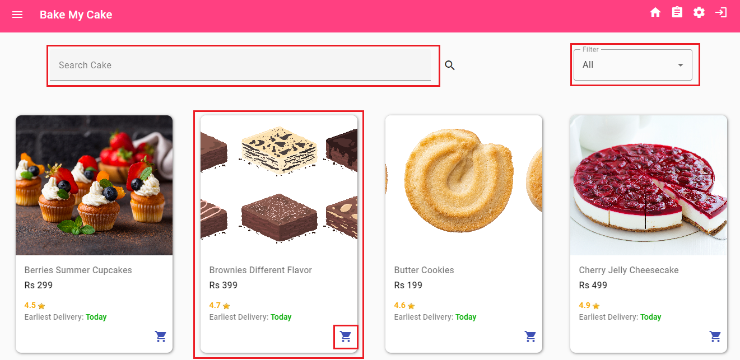
Landing View Output
user will be navigated to order-view

Slide 10
Designing Order View
The user will be navigated to the order view once he selects the item on the landing view.
The view should display the details of the item selected.
This view should all should allow users to provide details required for placing order for the selected item.
The details should be persisted, and the customer should be acknowledged after the order is successfully placed.
The app will request confirmation form the customer to leave the view, if the user attempts to navigate away from this view without submitting the request.

Slide 11
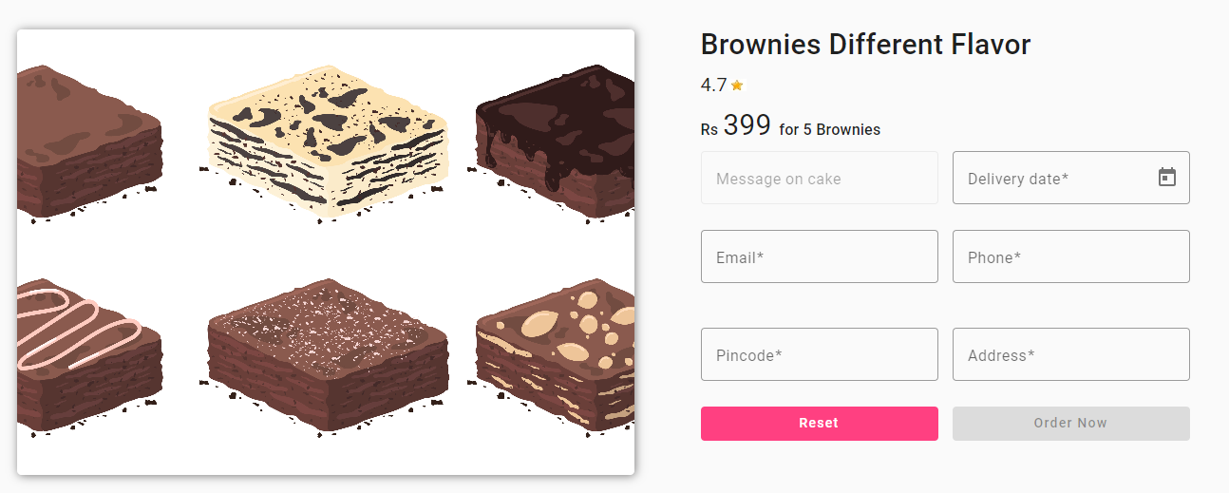
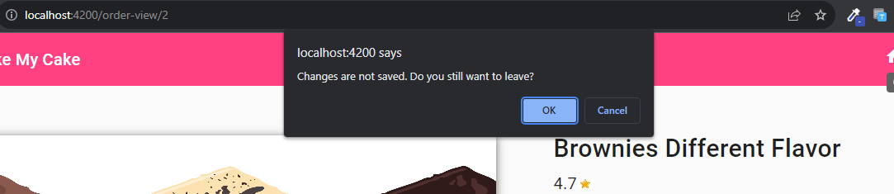
Order View Output

Slide 12
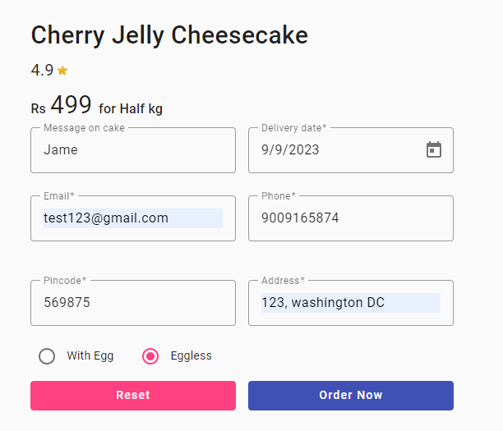
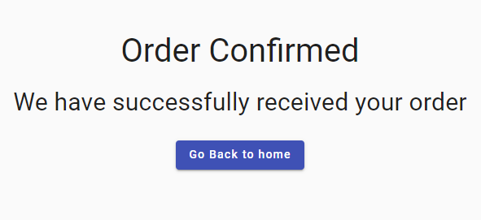
User is acknowledged after the order is successfully placed
User clicks on order now button after filling necessary details

Slide 13
Designing Login View
The user should be navigated to the login view if he attempts navigation to cake-requests view.
The view should request the user to enter the security code to login as admin.
Upon successful validation, the user should be navigated to the cake-requests view.

Slide 14
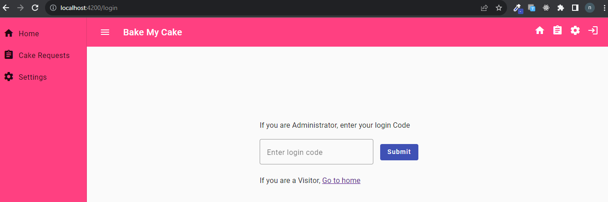
Login View Output
User gets navigated to login page
User wants to access cake requests view

Slide 15
Designing Cake Requests View
This view will display all the cake order requests received in tabular format.
This view has restricted access and is accessible only to the site administrator.

Slide 16
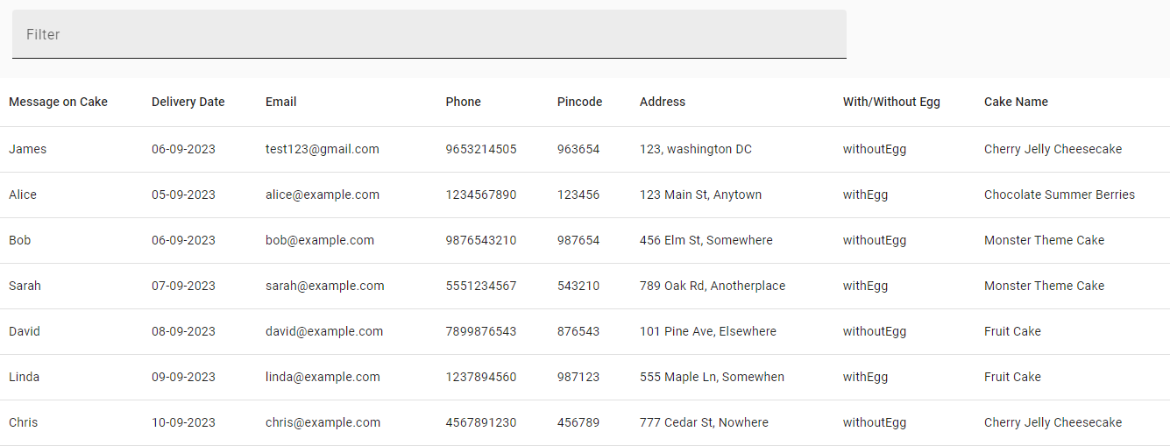
Cake Requests View Output

Slide 17
Key Features Of The Project
Used @Input() and @Output decorators to share data between the components having parent-child relationship.
Created angular services for developing reusable application logic.
Used HttpClient for making server requests.
Used ngOnInit() life cycle method for fetching data from the server and reading the route data.
Used template driven forms for designing interactive form fields.
Used Angular Router for enabling navigation in the application and Route Guards to protect routes with restricted access.

Slide 18
Thank you

